Slide 1
Australian Bush fire satellite data (NASA)
Group 3 Simon Gomes, Paula Beckett, Clinton Idehen, Joey Zheng

Slide 2
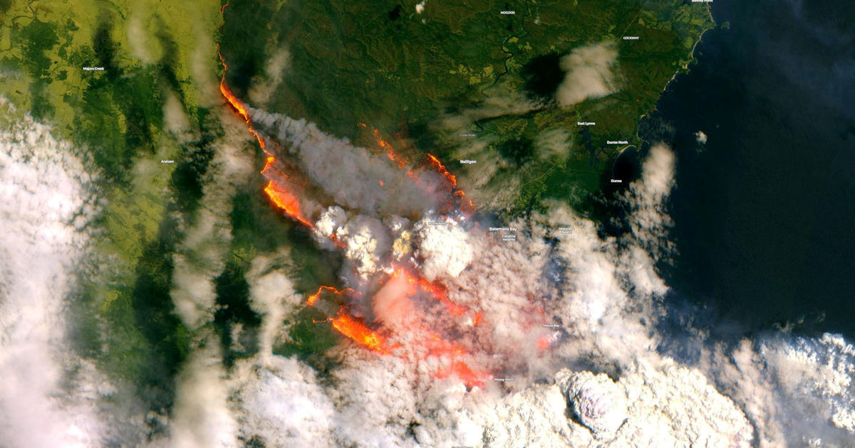
INTRODUCTION
The Australian Bushfires of 2019-2020 are referred to as Black Summer; a period that saw much devastation across the country.
Some confronting statistics from this period include:
243,000 square kms of land burnt
2,779 homes lost
34 people lost their lives
An estimated 3 billion land animals impacted, including some endangered species pushed to extinction
Smoke from the fires experienced 11,000kms away in Chile and Argentina
We are using this Project to tell a visual story about this period from a bird's eye view, with data gathered from the NASA satellites.
Batemans Bay, NSW
31st December 2019

Slide 3
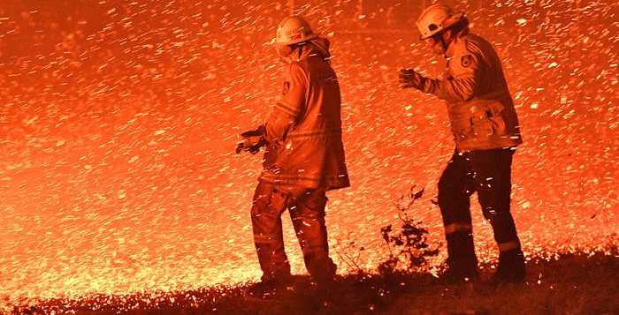

Slide 4
PROJECT 3
The primary goal of this project
to develop a web-based Flask application that analyzes and presents data from the 2019 Australian Bushfires.
Data Source
https://www.kaggle.com/datasets/nagarajbhat/australian-bush-fire-satellite-data-nasa
What we use to analyze
Python Flask-powered API
HTML/CSS
JavaScript
SQL
D3, Carto, Plotly & Chart.js

Slide 5
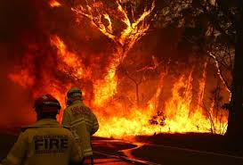
1
Data Flow Process

Slide 6
Data flow Process
Obtain data from Kaggle.com as csv files
Load data into SQL Database
Clean/transform data using SQL and export
Use Carto plugin for map generation
Use Plotly and Chart.js libraries for chart visualisations.
Use D3 for data manipulation to build charts & maps
Presented visualisations using HTML/CSS
Render charts/map data using Flask

Slide 7
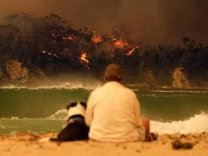
2
SQL Database

Slide 8
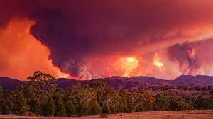
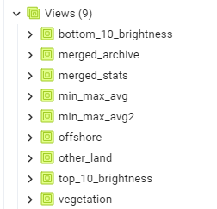
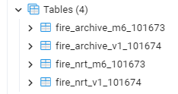
SQL Database
Create tables & import csv files
Merge files and save as a view
Noted data missing for October
Dataset had month of raw data that had not been calibrated by NASA, we did not use these files
Create SQL views to analyse data
Example: Grouped by date
Min/max/avg brightness readings
Count on daily readings
Count on locations of reading (type of terrain)
Export views as csv files
Although we have used a fixed period of 2019 the SQL Database is easily updated to build on this as more calibrated Satellite Data is made available from NASA

Slide 9
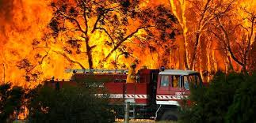
3
Fire Data by Day

Slide 10
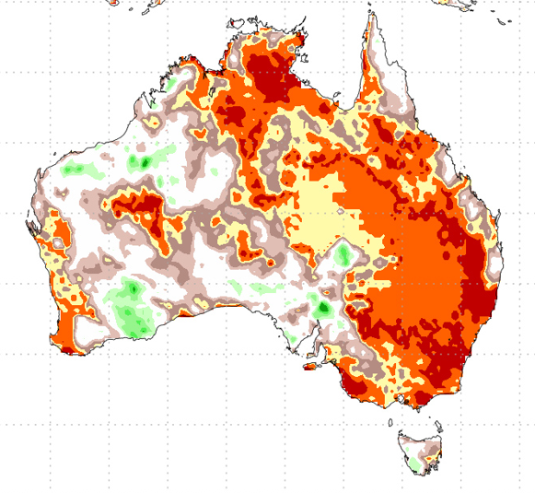
Brightness Temperature
Can we convert a brightness temperature, measured in Kelvin to degrees Celsius?
In short, no. Let’s start with what brightness temperature is with a quote from the American Meteorological Society’s Glossary of Meteorology
“A descriptive measure of radiation in terms of the temperature of a hypothetical blackbody emitting an identical amount of radiation at the same wavelength.
The brightness temperature is obtained by applying the inverse of the Planck function to the measured radiation. Depending on the nature of the source of radiation and any subsequent absorption, the brightness temperature may be independent of, or highly dependent on, the wavelength of the radiation.”
If we take some of our highest brightness temperature readings of 500°K, converting that to Celsius would give us 226.85°C, and although that is extremely hot, we know that bushfires burn much hotter than that with flame temperatures that can reach up to 1,100°C.

Slide 11
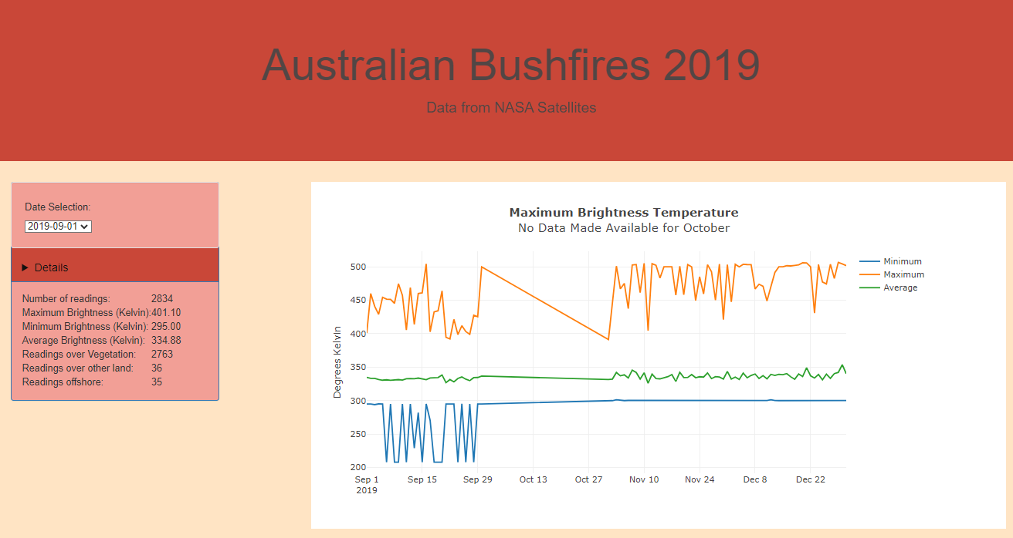

Slide 12
4
Fire Map

Slide 13
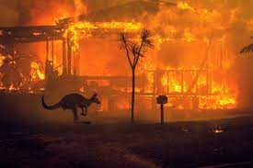
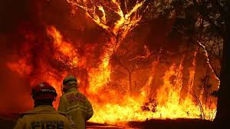
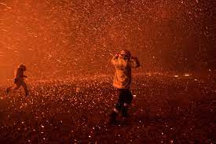
Fire Map
During the period from September 2019 to March 2020, Australia experienced a devastating bushfire season known as "Black Summer." In this unprecedented time, approximately 19 million hectares of Australian land were engulfed in flames, witnessing unusually intense and widespread bushfires across many regions of the country.
The dataset is a recording of (Moderate Resolution Imaging Spectroradiometer) from August 2019 to December 2019. There are 254,020 observations within the dataset.
To enhance this dataset, a dynamic map was created using Plotly to visualize the daily progression of fires across Australia. Although the image below captures a static snapshot, you can access the interactive map in HTML format in our GitHub page.

Slide 14
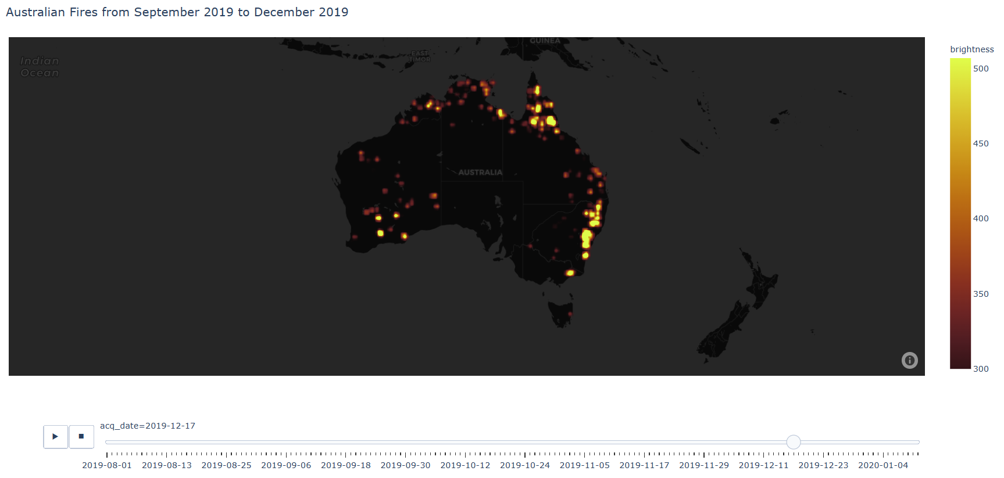

Slide 15
5
Satellite Data

Slide 16
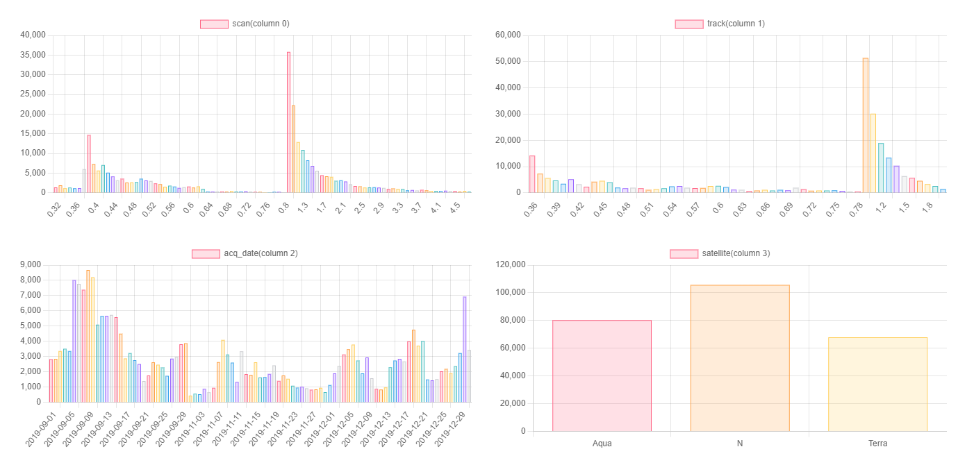
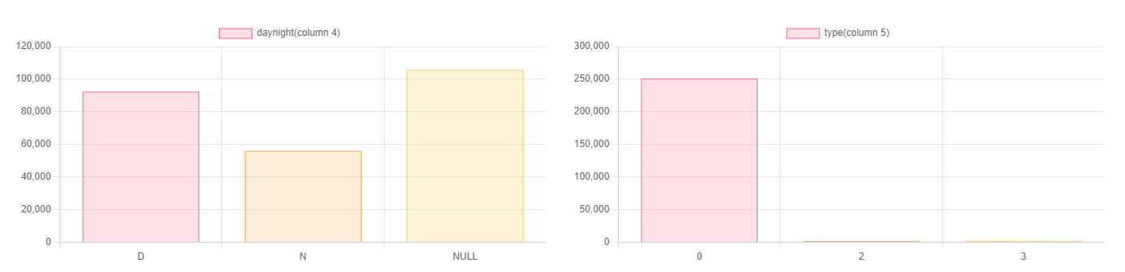
-Function: getDate(data)
This function takes an array data as input and returns a sorted list of unique elements from the input array. It uses an object map to count the occurrences of each element in the array and then sorts the keys of the map object to obtain the sorted list of unique elements.

Slide 17
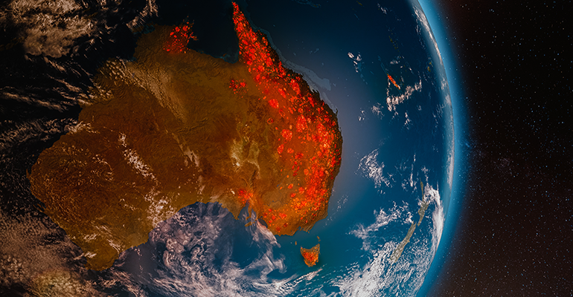
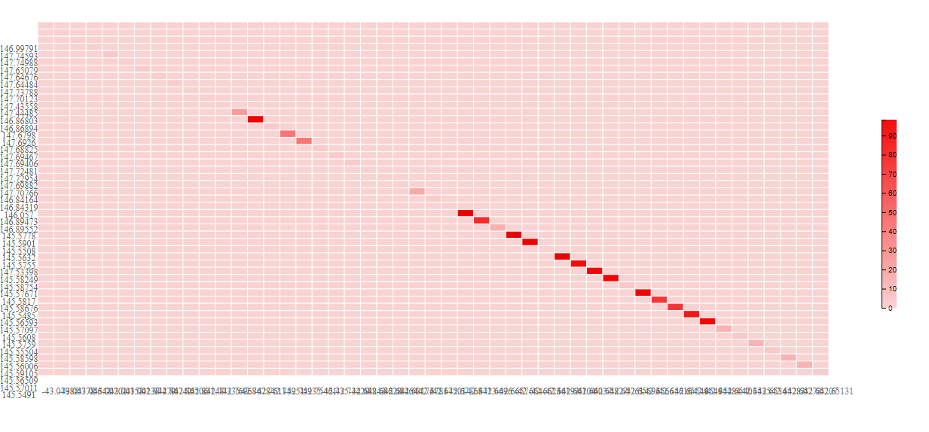
Latitude Longitude and FRP (Fire Radiative Power)
Latitude:-42.768
Longtitude:147.679888
FRP: 26.4
Latitude:-42.7682
Longtitude:145.57011
FRP: 15.5

Slide 18
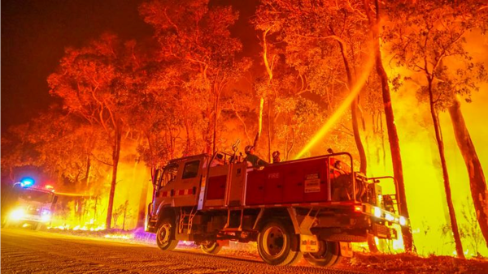
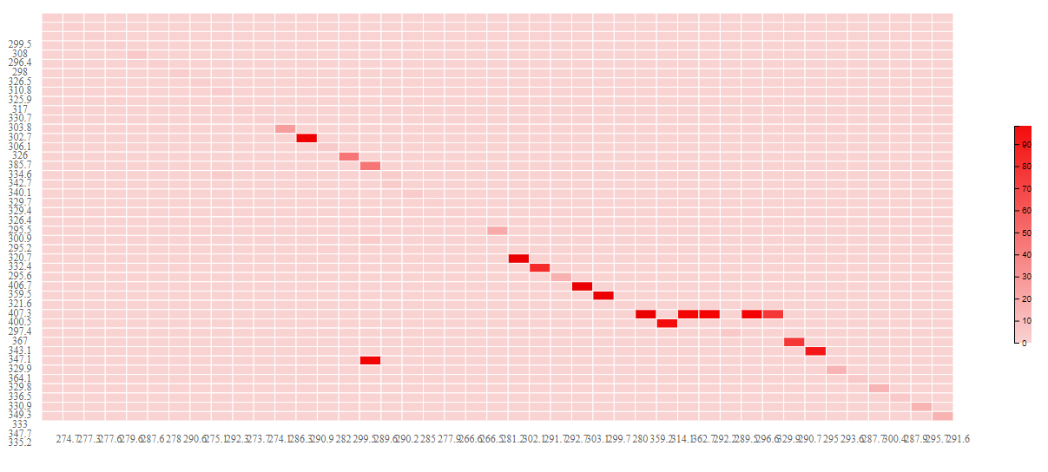
bright_ti4: 295 bright_ti5: 364.1
frp:92.9
bright_ti4: 302.1 bright_ti5: 406.7
frp:293.8
bright_ti4,bright_ti5
And
FRP
bright_ti4 and bright_ti5 has the linear relationship
FRP don’t has the close relationship with them

Slide 19
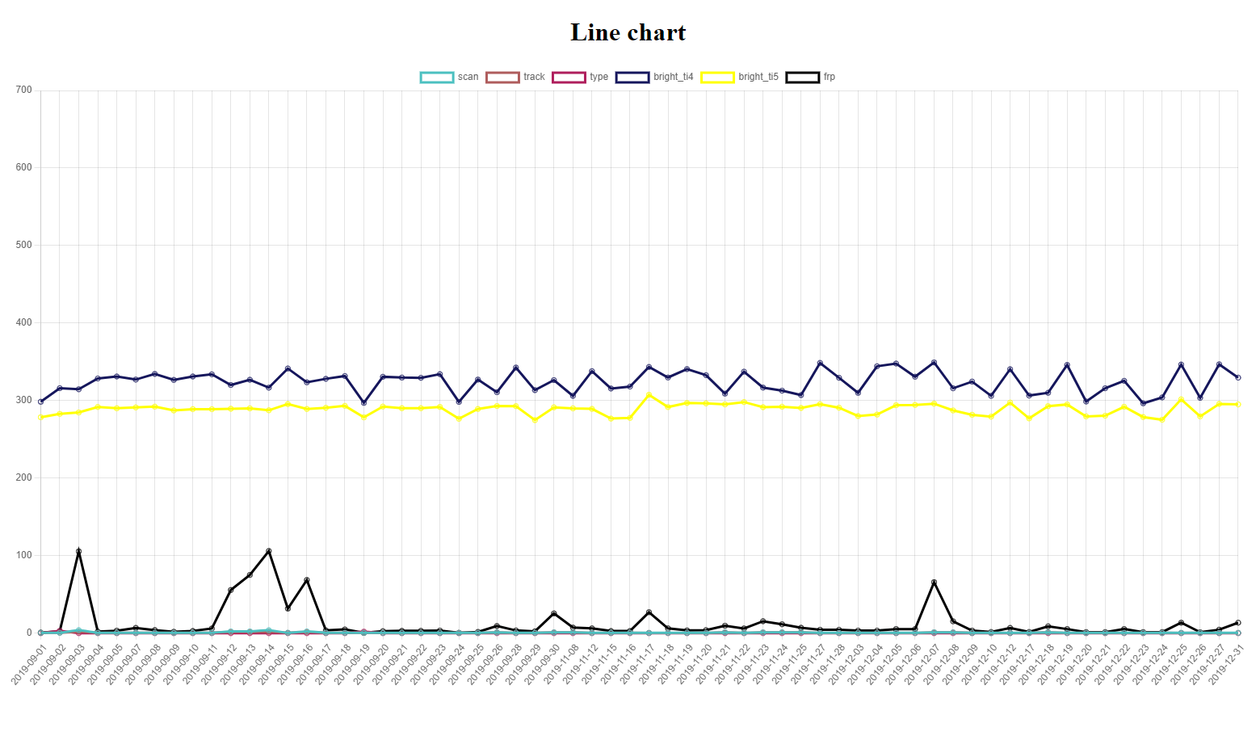
Line Chart by Dates
scan: Scan refers to the cross-track position of the satellite sensor as it scans the Earth's surface.
track: Track refers to the along-track position of the satellite sensor as it scans the Earth's surface.
type: This could refer to the type of fire detected, such as wildland fire, vegetation fire, or other types of thermal anomalies.
bright_ti4: The brightness temperature measured in Kelvin for thermal infrared band 4. This measurement is related to the temperature of the observed target, often used to detect and monitor wildfires.
bright_ti5: The brightness temperature measured in Kelvin for thermal infrared band 5. Similar to bright_ti4, this measurement is used to detect and monitor wildfires.
FRP: Fire Radiative Power, measured in Megawatts (MW). It provides an estimation of the rate of energy release from the fire.
Lines of scan and track - almost overlap
Lines of bright_ti4 and bright_ti5 - similar trend
FRP – Red circle for the peak energy release and normally the period lasting from 3-7 days

Slide 20
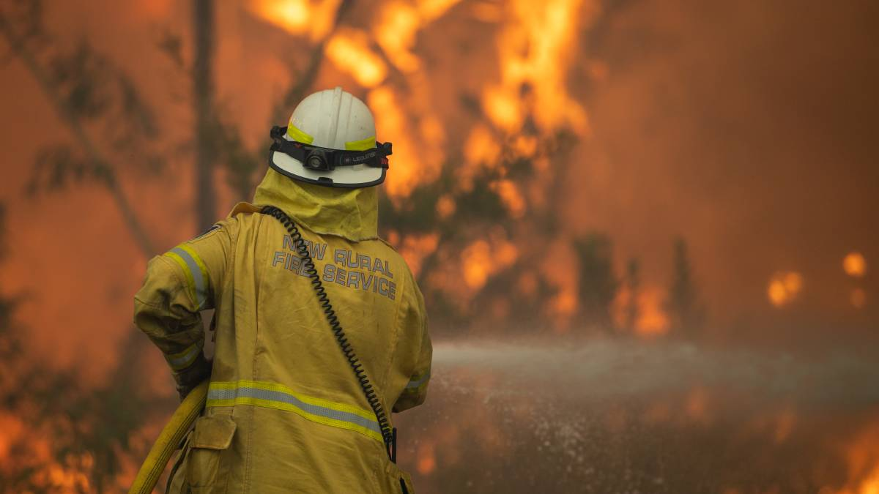
In conclusion, the devastating effects of the Black Summer bushfires cannot be underestimated, with the loss of countless homes, businesses, wildlife and landscapes. While the fires have been extinguished, the scars left by this event will be felt for years to come.
Thanks for all you do for us

Slide 21


